Slide 1
The curious case of plant responses to carbon dioxide

Slide 2
Why should we care about plant responses to CO₂?

Slide 3
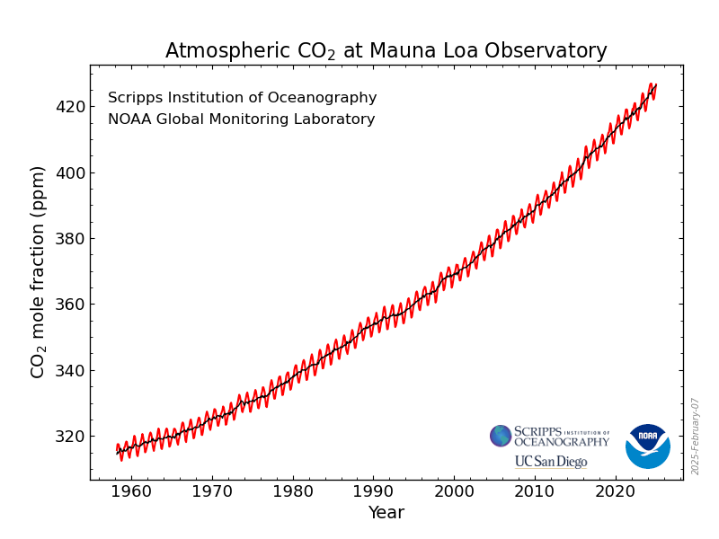

Slide 4
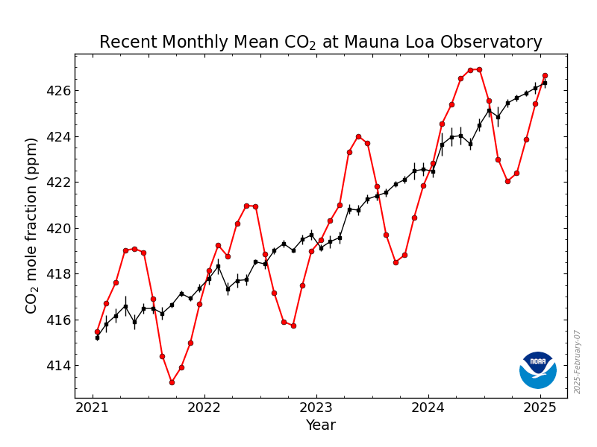
What causes the variations in the red line?

Slide 5
IPCC (2013)

Slide 6
What do you expect the plant response to be?

Slide 7
Short-term plant response to elevated CO₂: the A-Ci curve

Slide 8
Short-term plant responses to CO2: the A-Ci curve
Long et al. (2003)

Slide 9
Short-term plant responses to CO2: the A-Ci curve
CO₂
Rubisco binds CO2 to RuBP
3-C sugars created
3-C sugars prepared for export
RuBP is regenerated
Glucose et al.
Long et al. (2003)

Slide 10
Short-term plant responses to CO2: the A-Ci curve
CO₂
Rubisco binds CO2 to RuBP
3-C sugars created
3-C sugars prepared for export
RuBP is regenerated
Glucose et al.
Long et al. (2003)

Slide 11
Short-term plant responses to CO2: the A-Ci curve
CO₂
Rubisco binds CO2 to RuBP
3-C sugars created
3-C sugars prepared for export
RuBP is regenerated
Glucose et al.
Long et al. (2003)

Slide 12
Short-term plant responses to CO2: the A-Ci curve
CO₂
Hold on: What is strange about the RuBP regeneration response to CO₂?
Rubisco binds CO2 to RuBP
3-C sugars created
3-C sugars prepared for export
RuBP is regenerated
Glucose et al.
Long et al. (2003)

Slide 13
Short-term plant responses to CO2: the A-Ci curve
CO₂
Rubisco binds CO2 to RuBP
3-C sugars created
3-C sugars prepared for export
RuBP is regenerated
Glucose et al.
Long et al. (2003)

Slide 14
This response is relatively consistent across species and fairly easy to measure!

Slide 15
What do you expect the plant response to be?

Slide 16
How might the long-term response to elevated CO₂ differ?

Slide 17
How might the long-term response to elevated CO₂ differ?
Things to consider:
Each component represents a within leaf investment
Plants generally aim for efficiency
RuBP regeneration is principally determined by light availability
Rubisco is an expensive enzyme (lots of N)
It’s costly to use water

Slide 18
Free Air CO₂ enrichment (FACE) experiments

Slide 19
Ainsworth and Long (2005)

Slide 20
Ainsworth and Long (2005)

Slide 21
What does this mean for the whole plant?

Slide 22
What does this mean for the whole ecosystem?

Slide 23
What do you expect the plant response to be?
Draw a systems diagram

Slide 24
Bazzaz figure for discussion

Slide 25
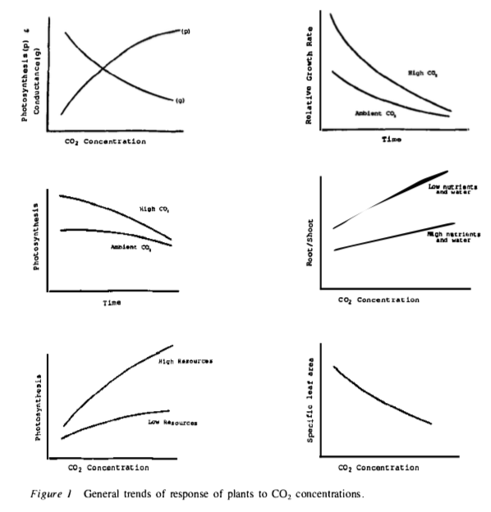
Bazzaz (1990)

